Slide 1
Support Vector Machines
Brief Introduction

Slide 2
Support Vector Machines
Find a linear hyperplane (decision boundary) that will separate the data

Slide 3
Support Vector Machines
One Possible Solution

Slide 4
Support Vector Machines
Another possible solution

Slide 5
Support Vector Machines
Other possible solutions

Slide 6
Support Vector Machines
Which one is better? B1 or B2?
How do you define better?

Slide 7
Support Vector Machines
Find hyperplane maximizes the margin => B1 is better than B2

Slide 8
Support Vector Machines

Slide 9
Support Vector Machines
What if the problem is not linearly separable?

Slide 10
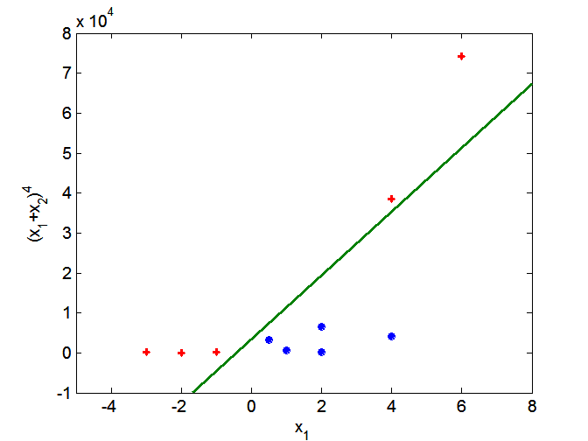
Nonlinear Support Vector Machines
Transform data into higher dimensional space

